Slide 1
Dr. Gelly Aroni Special Secretariat for the Protection of Unaccompanied Minors Ministry of Migration and Asylum, Greece a.aroni@migration.gov.gr

Slide 2
Challenges
The dominant school practice is still based upon the values, norms and experiences of the native population.
Curriculum bias values majority culture.
Inappropriate assessment tests.
Clustering of migrant and refugee students in underperforming schools.
Technological innovation and digital tools put into the spotlight due to COVID-19 crisis have widened inequalities instead of narrowing them.

Slide 3
Opportunities
“Refugee students brings to school wealth and challenge….. If these children have been so competent to survive everything they had to, then we have a lot to learn from them”.
High School Principal

Slide 4
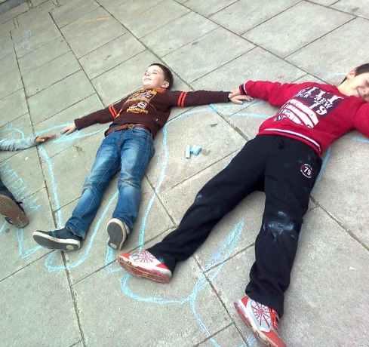
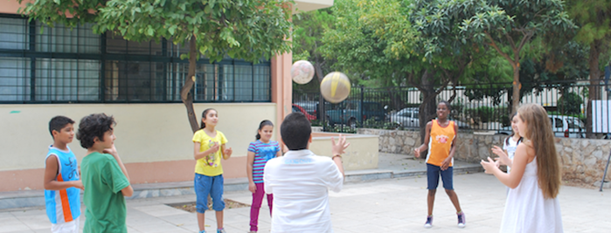
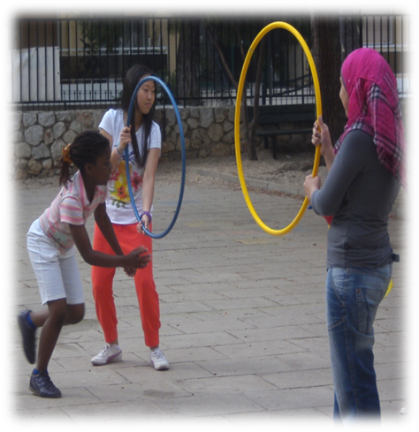
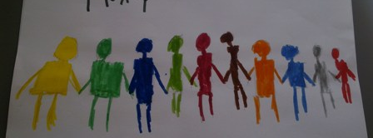
A new asset-based approach is needed, which highlights what these students have in contrast to the often-used deficit-based thinking which emphasize what they lack.

Slide 5
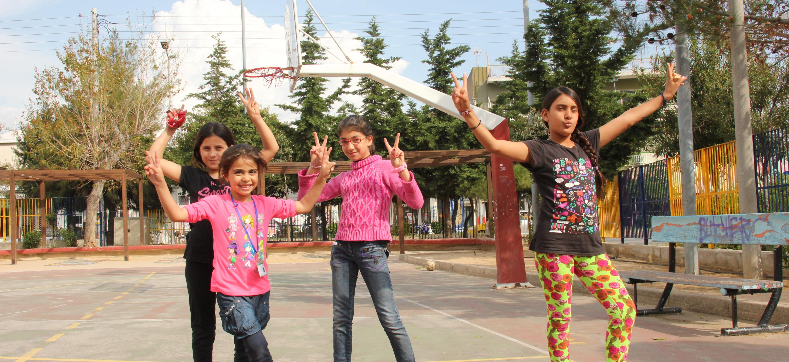
Migrant and refugee students bring with them a wide array of skills and strengths to classrooms and communities.
Many have navigated multiple countries and schools, and their persistence, perseverance and adaptation skills are striking. Some have demonstrated tremendous resilience, surviving natural disasters, armed conflicts, wars, refugee camps.
They have determination, courage, and problem-solving skills.
Many speak two, three, and sometimes as many as four languages.

Slide 6
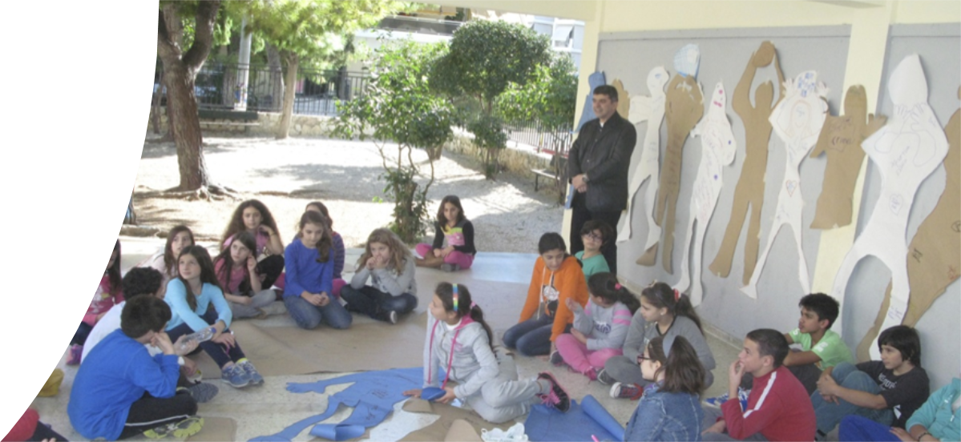
Through language acquisition they acculturate faster than their parents whom they assist in translation, mediation and other cultural bridging.
In school, they support classmates, bridging the gap between teachers and the most recent arrivals.
Outside of class, they often work long hours to help support their families or they act as essential caregivers to younger siblings, especially girls.
They can make us appreciate our life and everything we take for granted.

Slide 7
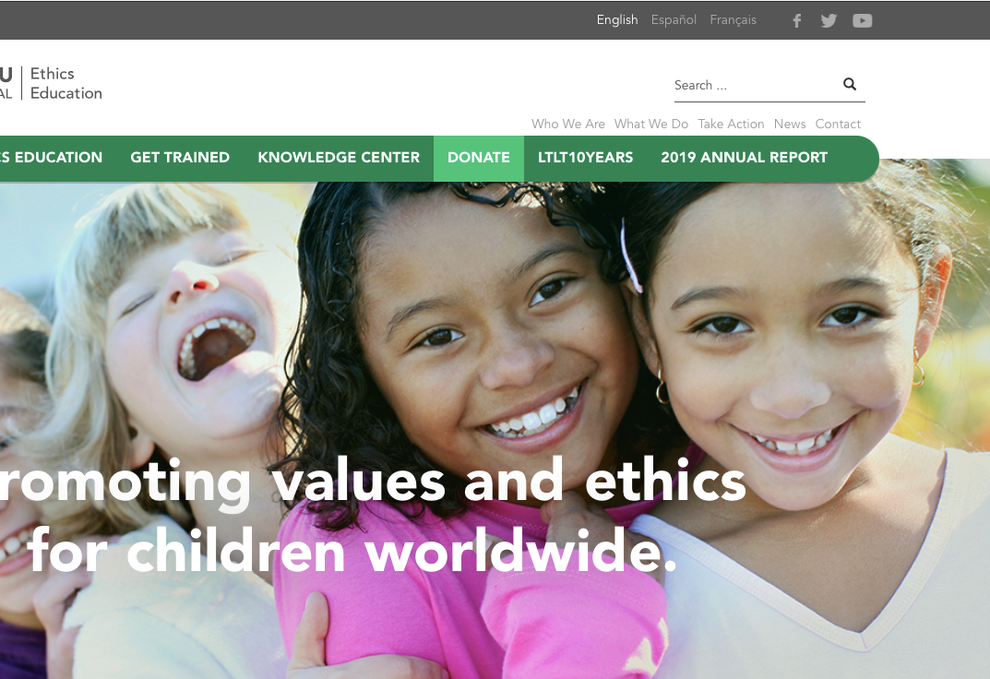
Ethics education can contribute to socio-emotional learning as it values being rather than doing, promoting learners’ wellbeing.
It can mitigate the psychosocial impact of conflict and disasters by providing a safe and stable learning environment restoring a sense of normalcy, dignity and hope by offering structured, appropriate and supportive activities.

Slide 8
Greece: 98% Christian Orthodox
Learning to Live Together can contribute to the Interfaith dimension of ethics education in a country that is considered largely mono-ethnic, mono-cultural and mono-religious.
Notes:
This is not an easy task. But as the Nobel awarded Greek poet Odysseas Elytis wrote:

Slide 9
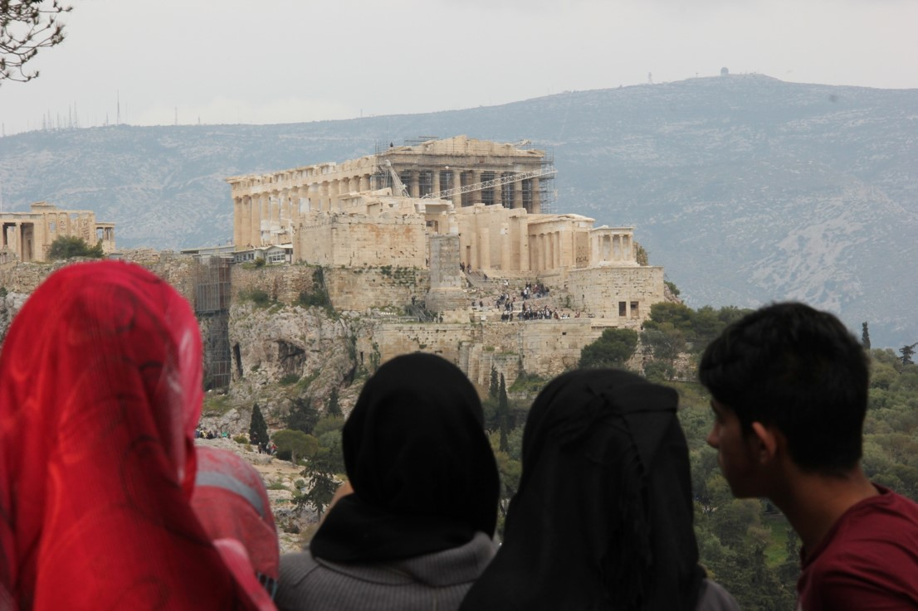
“When you cannot
find spring
you make it”
Odysseas Elytis
Thank you

